Slide 1
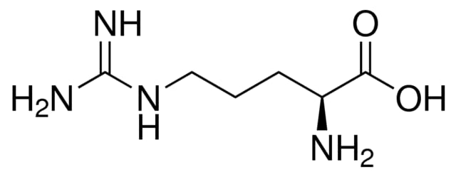
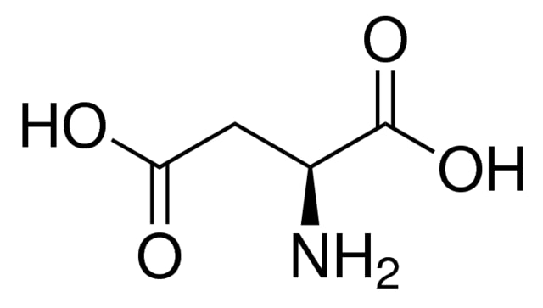
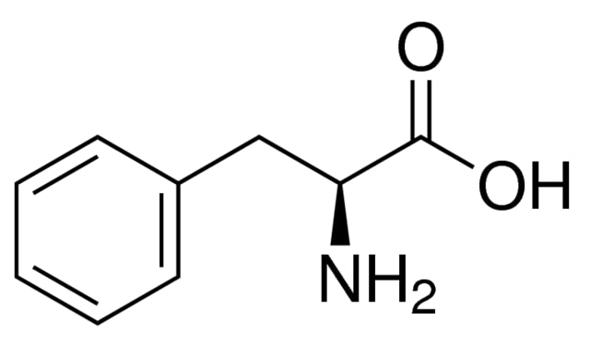
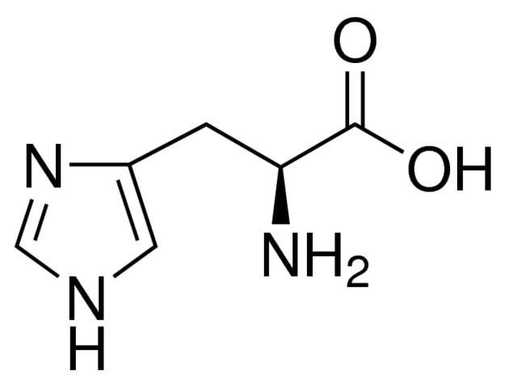
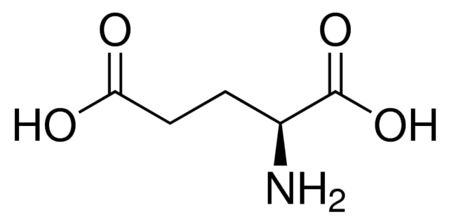
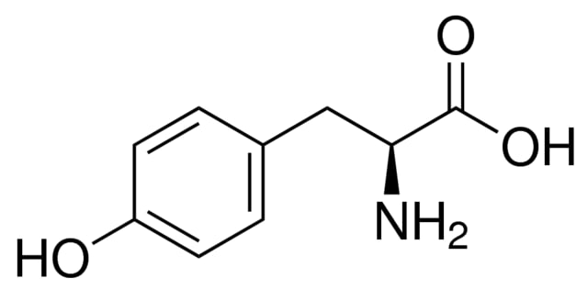
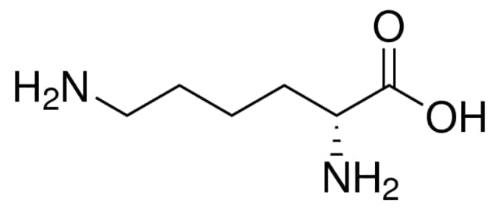
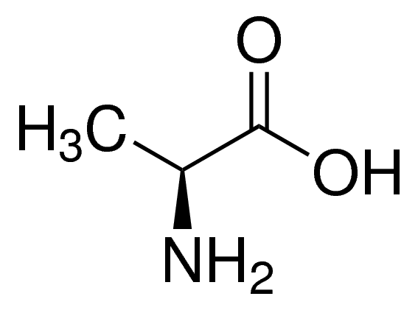
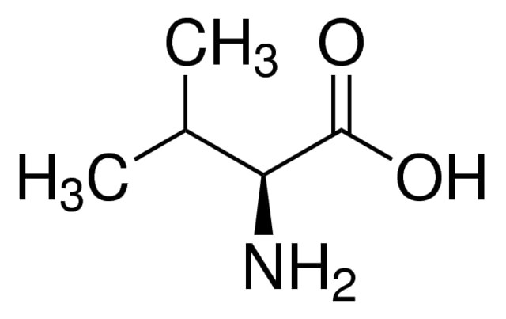
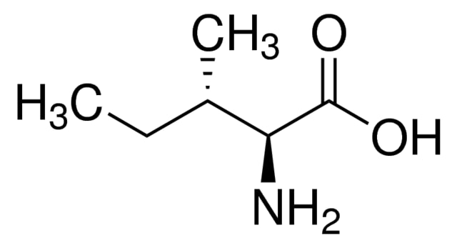
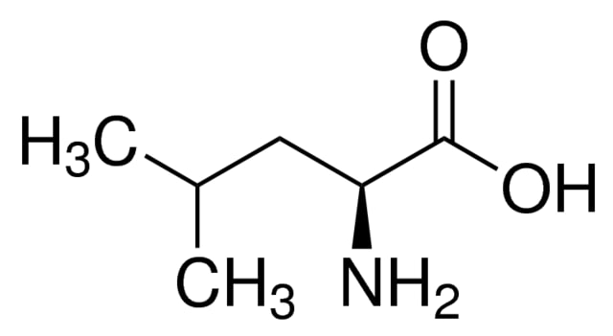
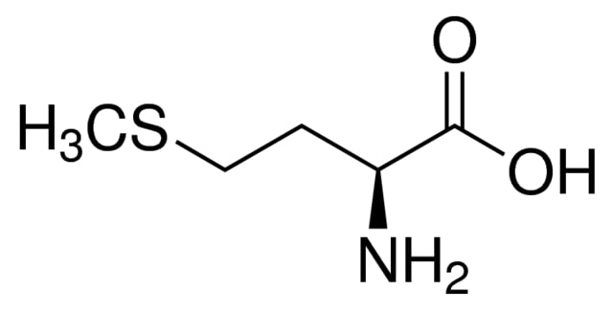
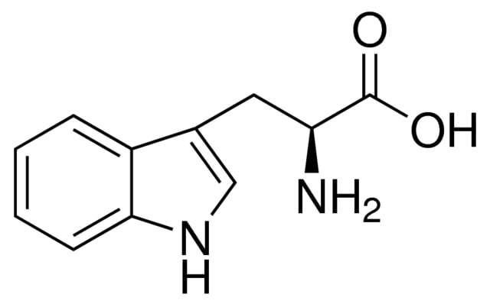
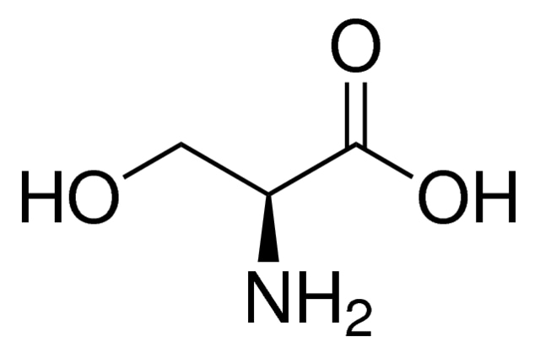
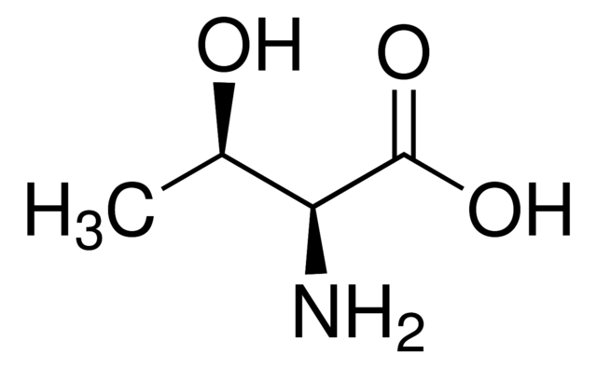
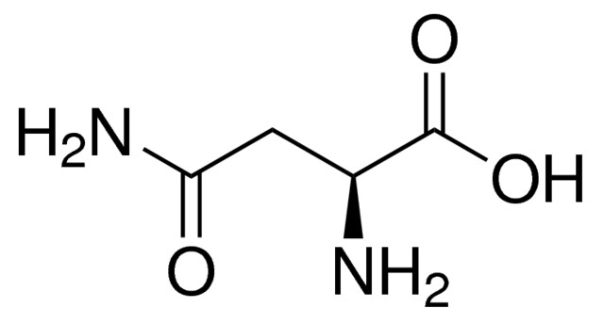
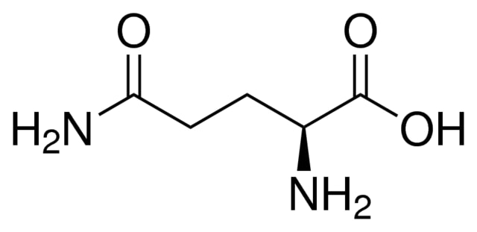
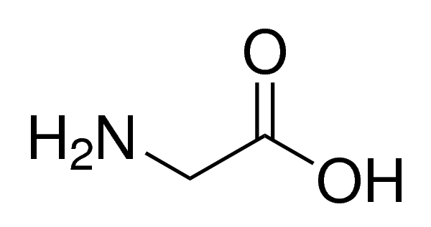
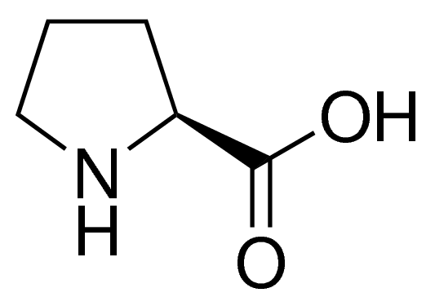

Positively charged
Negatively charged
Hydrophobic (Aromatic)
Arg (R)
Asp (D)
*
pI=10.8
pI=2.8
Phe (F)
*
pI=5.5
His (H)
pI=7.6
Glu (E)
*
Tyr (Y)
Lys (K)
pI=3.2
pI=9.7
pI=5.7
Hydrophobic (non-aramomatic)
*
*
*
Tryp (W)
Ala (A)
*
Ile (I)
*
pI=5.9
pI=6.0
Val (V)
Leu (L)
Met (M)
pI=6.0
pI=6.0
pI=6.0
pI=5.7
Polar uncharged
Special cases
*
Asn (N)
Ser (S)
Thr (T)
pI=5.4
Gln (Q)
Gly (G)
Pro (P)
Cys (C)
pI=5.7
pI=5.6
pI=5.7
pI=6.0
pI=6.3
pI=5.1

